Slide 1
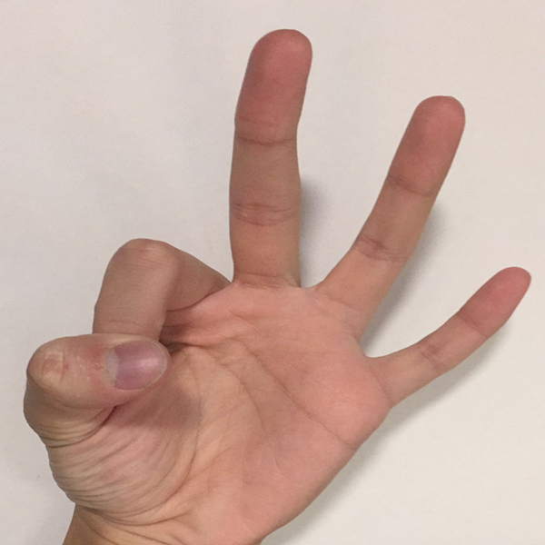

Finger Number Recognition by TensorFlow on Android
Lun Jiang
Applied Math
University of Washington

Slide 2
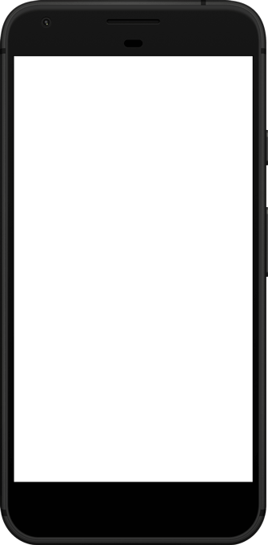


Purpose of the App
Basic idea: To classify the number representation of a finger in a picture:
…
3
Photo Capture
Android Device
with TensorFlow
Number Classification
Following Steps

Slide 3
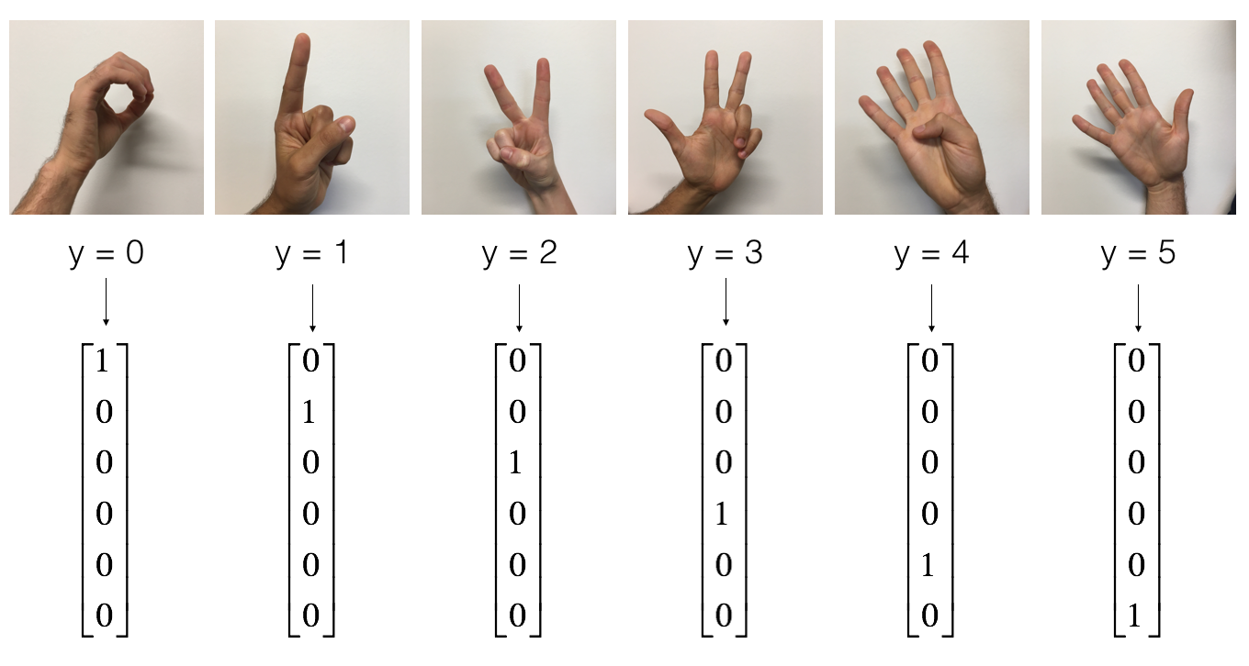
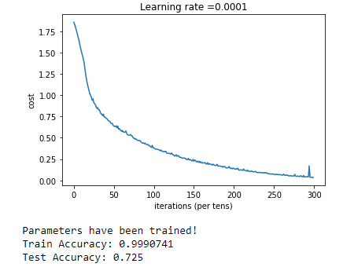
Principle of the TensorFlow Classifier
Use a simple linear classifier implemented by TensorFlow:
LINEAR -> RELU -> LINEAR -> RELU -> LINEAR -> SOFTMAX
From the Week3 Assignment of course:
Improving Deep Neural Networks:
Hyperparameter tuning, Regularization and Optimization
On Coursera, by Andrew Ng

Slide 4
Android Implementation
Building Blocks:
Activities:
Android TensorFlow Interface:
button which triggers an action when clicked
display a pop-up message ("toast")
display a list of items to choose from
display an image
display a web page
composed of at least 2 linked activities
pass information from one activity to the next
PhotoActivity.java
RecognitionActivity.java
SearchActivity.java
The Flowchart of the entire process is shown on the next page.
Use existing interface TensorFlowInferenceInterface.java
From GitHub Repo: tensorflow
Use existing module TensorFlowClassifier.java
From GitHub Repo: A_Guide_to_Running_Tensorflow_Models_on_Android
The parameters in the linear classifier are trained locally.

Slide 5
Flowchart of Design
PhotoActivity.java
activity_photo.xml
RecognitionActivity.java
activity_recognition.xml
SearchActivity.java
activity_search.xml
Launch App
TensorFlow
Recognize
Button: exit
Take a Photo
Calculate Result
Present Results in the Selected Languages
Button: take
Radio Group: Options
Satisfied?
No
YES
FINISH
Button: confirm
Button: confirm
Button: finish_go
ABANDON
Button: next
Number Picker:
Language
SUM-UP
Button: take_another
Web Search

Slide 6
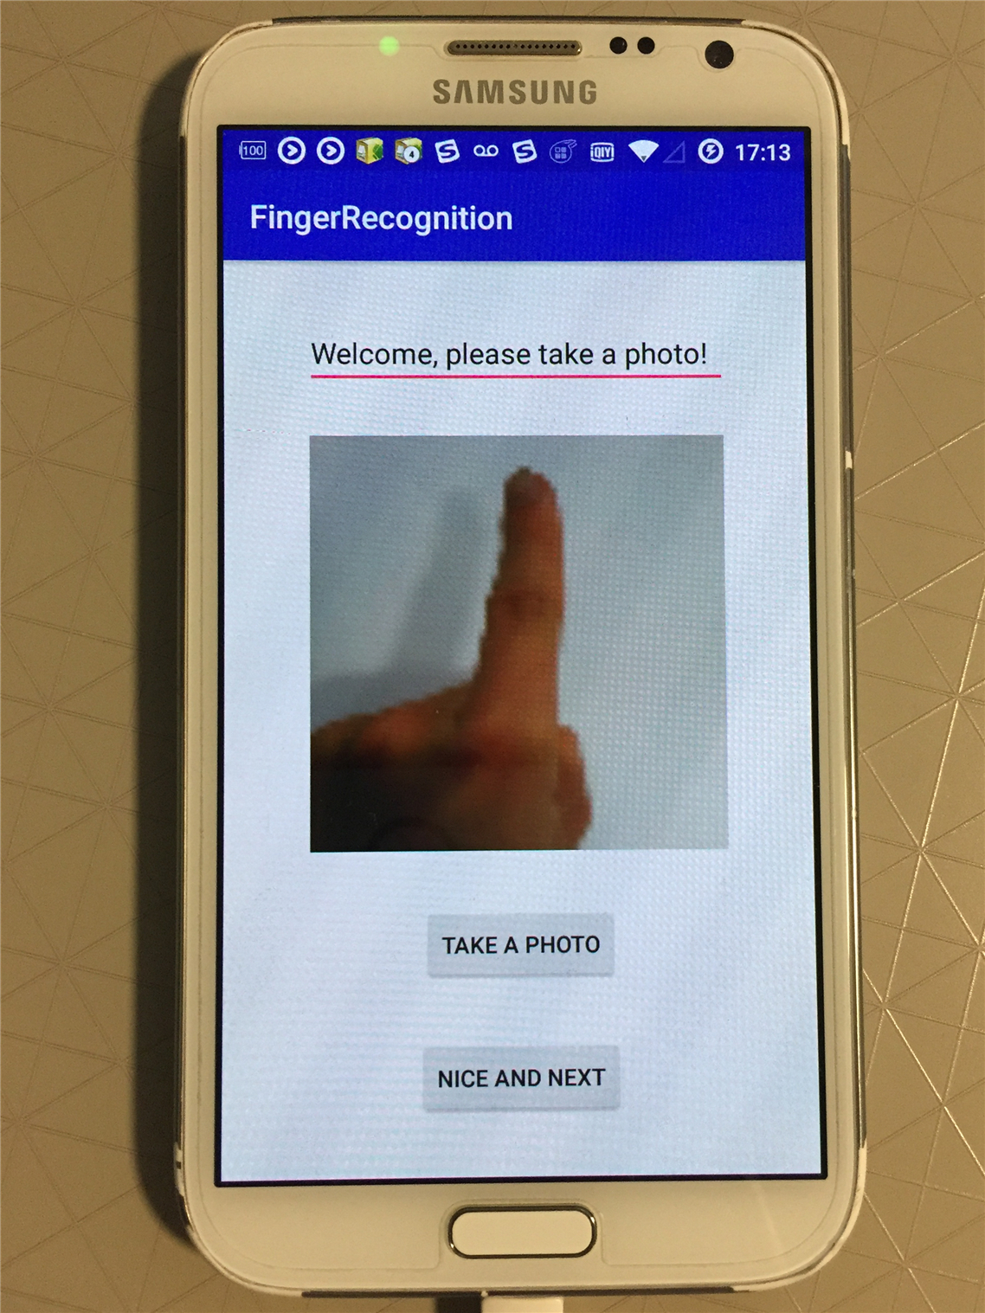
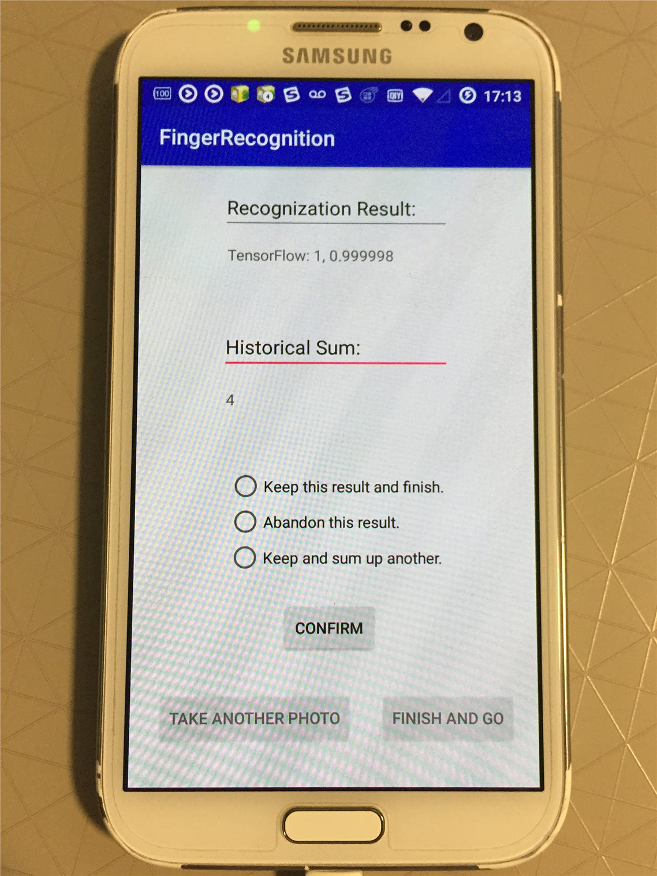
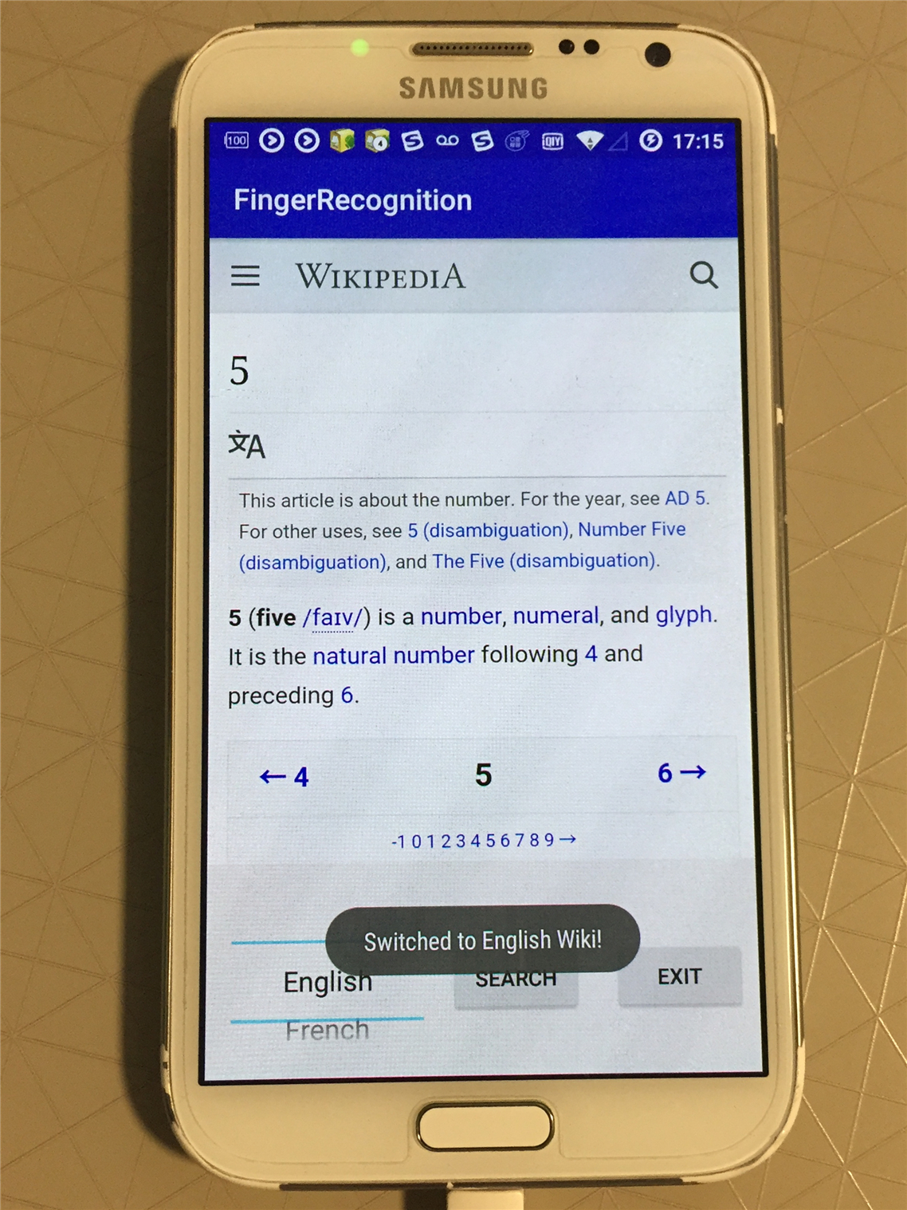
Results of the App
PhotoActivity:
RecognitionActivity:
SearchActivity:

Slide 7
Feedbacks of Use
Positive
Negative
To be done:
Building blocks listed above are applied and utilized.
Communication between multiple activities work properly.
Logics and relationships shown in the flowchart are exactly implemented.
The testing accuracy of the current model in the device is very very LOW, which may be due to the reason that the distributions of data in the training set and testing set differ significantly, such that the trained neural network are overfitted to the online training data source.
May use more complicated convolutional neural network instead of the simple linear classifier to improve accuracy.
May use the local data gathered by the testing devices to train the network. But this may cause overfitting again when using the app on another device.

Slide 8
Thanks for Watching!
The source code of this project is available on GitHub:
https://github.com/Lunj12/finger-android/
Lun Jiang
Applied Math
University of Washington

